Slide 1
Ames Housing Dataset
Group 6
Yong Tat
Elliot
Joseph
Jack
Notes:
Elliot: 1 - 4
Jack: 5 - 9
Joseph: 14 - 18
Yong Tat: 10 - 13, 19

Slide 2
Problem Statement
We are freelance data analysts building a housing price prediction model.
Stakeholders
Our prime stakeholders are property agents/agencies based in Ames, who will use the model to manage their potential buyers' expectations.
Approach
Our approach of this project is to study the historical housing prices in Ames and the housing dataset features provided by Ames, Iowa Assessor's Office. We will build a linear regression model, and will be evaluating its performance using the Root Mean Squared Error (RMSE) metric. The processes involve data preparation, data massage, data visualization, regularization and recursive feature elimination.
Data source
The housing data set provides historical housing prices from 2006 to 2010, and 80 other features related to the property, locations and sales processes.

Slide 3
Methodology
Methodology
Exploratory Data Analysis and Data cleaning
Feature Engineering
Feature Selection
Model Building and Model Iteration
Model Inference and Conclusion
Barplot
Check the distribution to see if any categories have majority of values
Boxplot
To observe the effect of categorical variable to the SalePrice
Scatterplot
Checking for linear correlation between numerical variables and SalePrice
Heatmap
To check the collinearity between the numerical variables
Visualizations
Box plots
Histograms
Scatter plots
Imputation of null values
26 features with null values
Removal of outliers
2 extremely large houses with low SalePrice
Feature combination
Combining features that have similar interest and create a new feature for the combined features
Encoding of ordinal categorical features
1, 2, 3, 4, 5...
One-hot encoding
Creation of dummy variables for categorical features
Regularization
Use of regularization models like Ridge, Lasso and ElasticNet for feature selection
RFE
Use Recursive Feature Elimination to select top features
Insights from our model
Magnitude and direction of coefficients
Model limitations
Linearity assumptions
Recommendations
How does this address our problem statement?

Slide 4
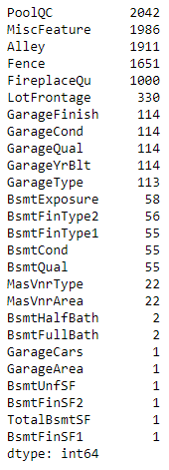
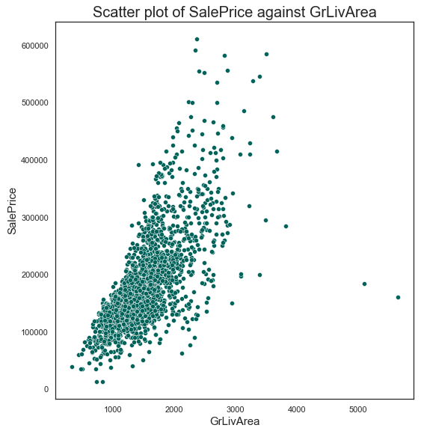
Data Cleaning
Handling of null values
Categorical features were imputed with ‘None’
Numerical features were imputed with the mean/median
Dropping of outliers
A plot of SalePrice vs. GrLivArea reveals two transactions that had GrLivArea > 5000 sq ft
These were dropped to improve the linear fit of our model

Slide 5
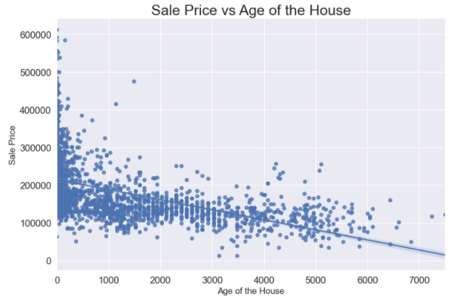
Feature Engineering
For the new `overall_age` feature, I have applied the polynomial features method to combine the `house_age` and `remod_age` features. All these features are related to age of the house with/ or without remodeling.
From the scatterplot, you can see that increasing of the `overall_age` value will decrease the `saleprice` which is expected.

Slide 6
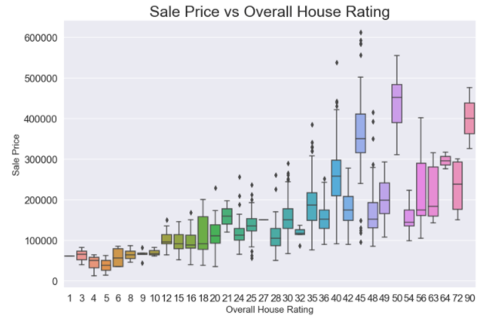
Feature Engineering
For the new `overall` feature, we applied the polynomial features method to combine the `overall_qual` and `overall_cond`. These 2 features are the overall rating of the house in term of materials used, finishing and condition of the house. The sub-features are based on the existing pointing system.
From the boxplot, you can see that increasing of the `overall` value will increase the `saleprice` which is good.

Slide 7
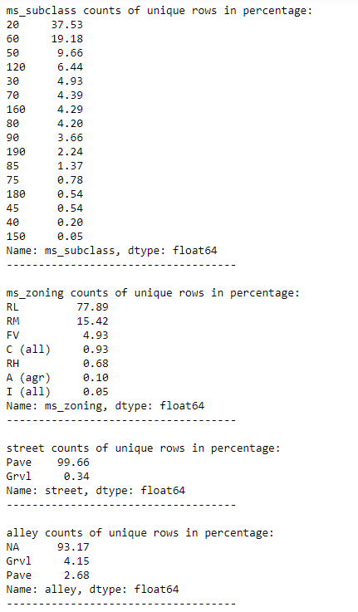
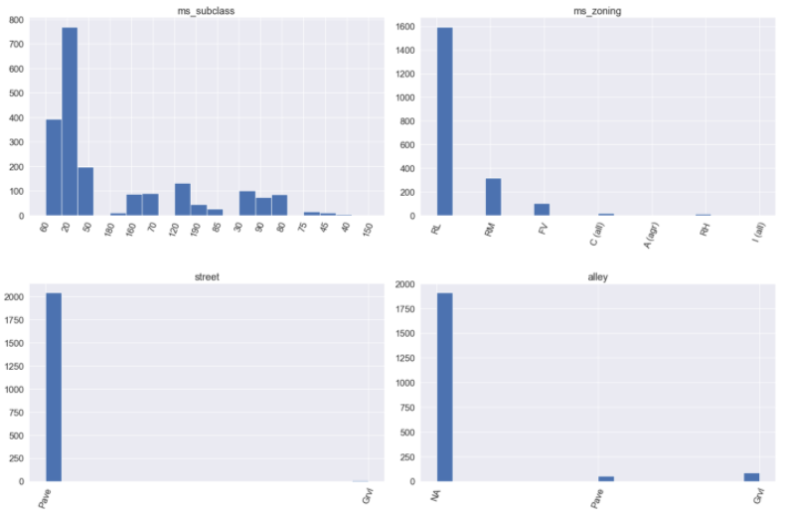
Feature Selection (Bar Plot)
We notice that there are plenty of features have one value is heavily over presented.
We will not use the features with frequency of one value more than 70% for my price prediction.

Slide 8
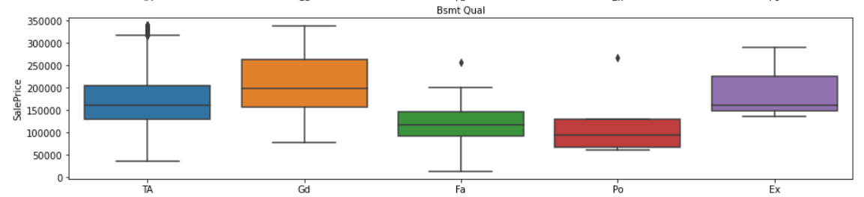
Feature Selection (Box Plot)
If the categorical variable has an effect on SalePrice, the different categories will have different SalePrice.

Slide 9
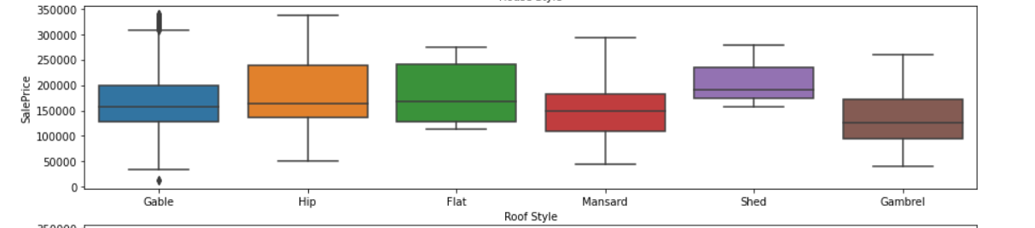
Feature Selection (Box Plot), cont’d
If the categorical variable has no effect on SalePrice, the different categories will have around the same SalePrice.

Slide 10
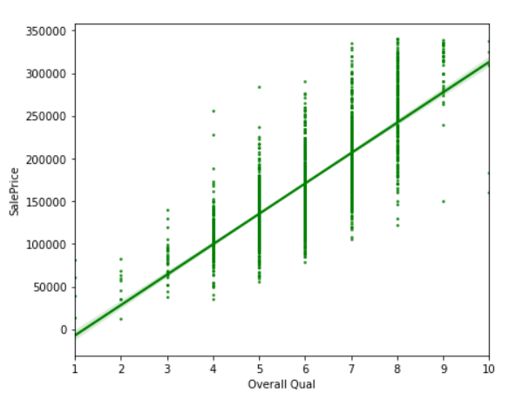
Feature Selection (Scatter Plot)
If the variable has a linear correlation with SalePrice, it will follow the pattern like the diagram.

Slide 11
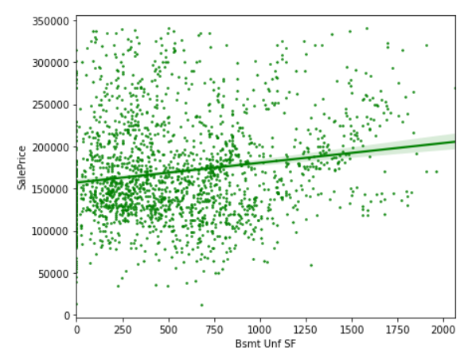
Feature Selection (Scatter Plot), cont’d
If the variable has no linear correlation with SalePrice, it will follow the pattern like the diagram.

Slide 12
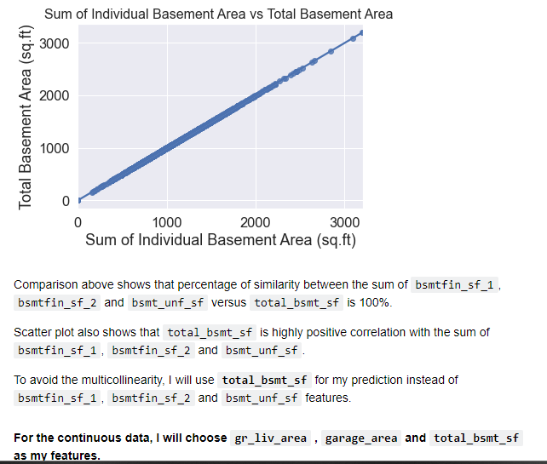
Feature Selection (Scatter Plot), cont’d
If the variables have co-linearity, it will follow the pattern like the diagram.
The graph shows a near perfect co-linearity; total Basement Area is plotted against Sum of Individual Basement Area.
Hence only 1 feature needs to be used.

Slide 13
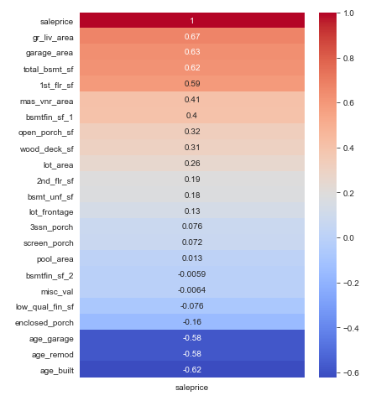
Feature Selection (Heatmap)
If the variable has low correlation with SalePrice, the feature can be dropped.

Slide 14
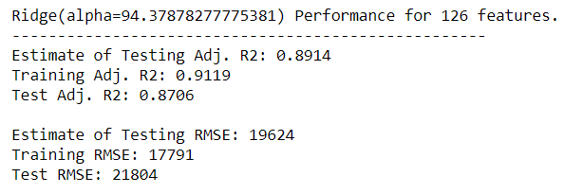
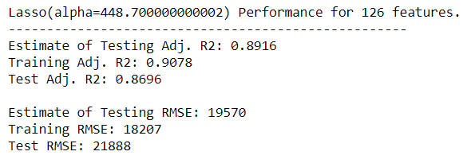
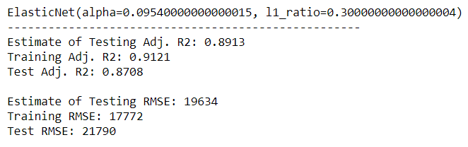
Model Building & Iteration
Regularization was done with Ridge, Lasso and ElasticNet models
ElasticNet performed the best, with lowest Adj R2 score of 0.8708 and RMSE of 21790.

Slide 15
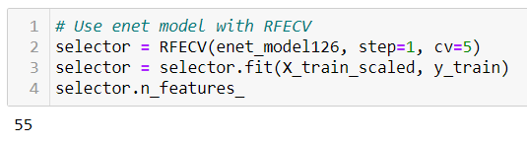
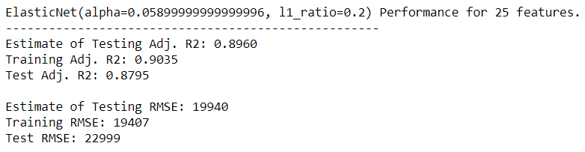
RFE
Using RFECV, 55 features was the optimal number given
For a more business friendly and interpretable model, 25 features were used but this had increased RMSE

Slide 16
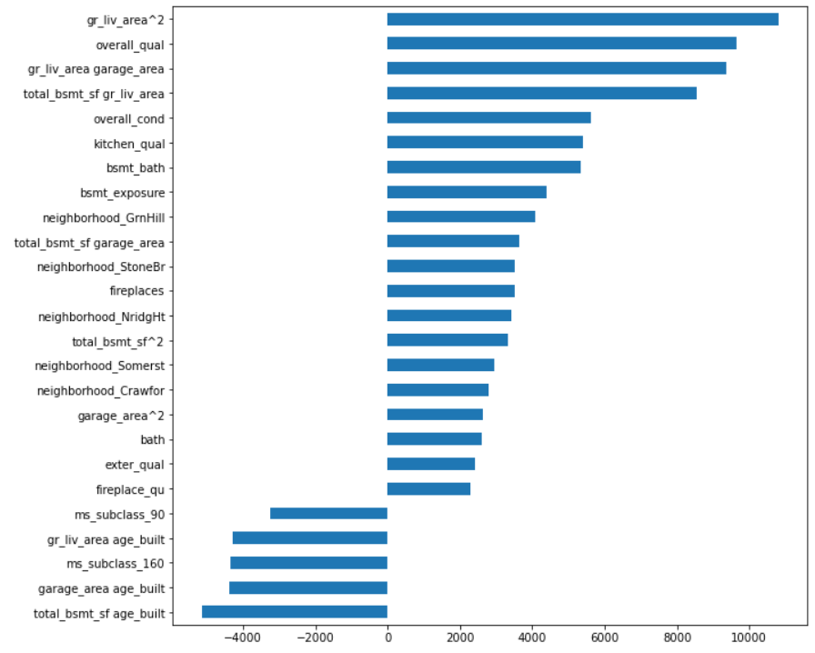
Results
Coefficients from RFE with ElasticNet
Adj R2: 0.8795 RMSE: 22999
Top positively correlated features
Above Ground Living Area
Overall Quality
Garage Area
Top negative correlated features
Bsmt Age
Garage Age
MS Subclass 160 (2-STORY PUD - 1946 & NEWER)

Slide 17
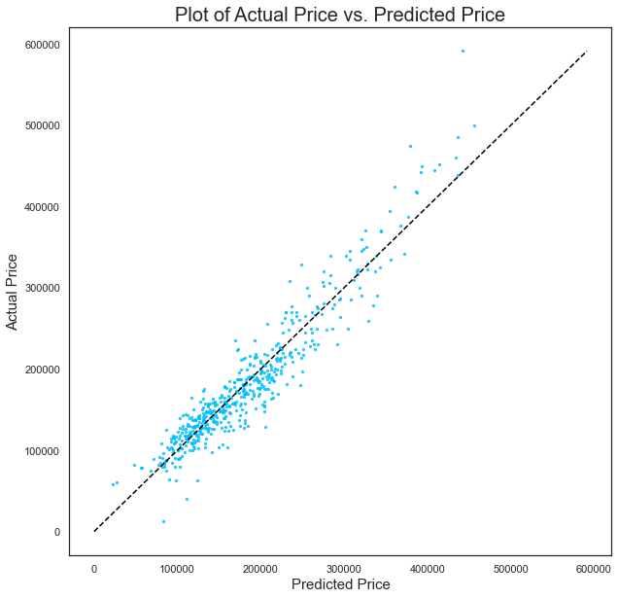
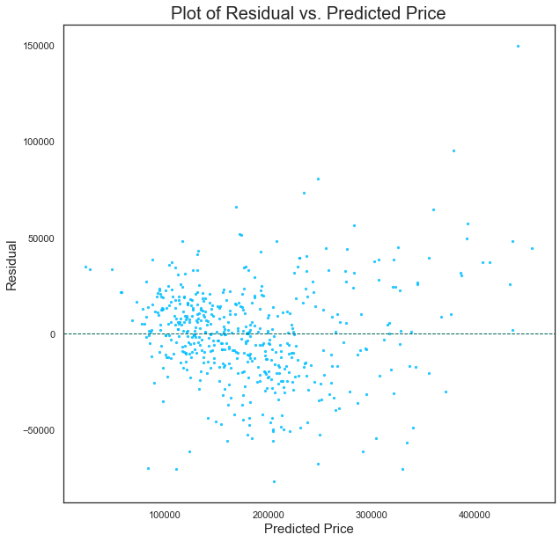
Results
Majority of predicted prices roughly coincide with actual prices
However, tends to undervalue houses > 350k
Residual plot shows that errors are not homoscedastic
Residuals are more sparsely distributed as price increases

Slide 18
Recommendations
Property agents/agencies can consider making use of the model to better understand the factors affecting SalePrice, so as to manage their potential buyers' expectations:
Gr Liv Area (Above ground living area square feet) and overall_qual (overall material and finish of the house) adds the most value to a home.
Combined effect of Total Bsmt SF (Total square feet of basement area) and age_built (Age of the property, calculated from year built) hurt the value of a home the most.
As the size of one's house is typically already fixed, homeowners who hope to increase the value can work towards remodelling the kitchen, fireplace and basement area. Regular facade maintenance also goes a long way in bringing up the price of the house.
The neighbourhoods of Green Hills, Stone Brook, Northridge Heights might be good investments.
This model will not generalize well to other cities since it includes specific neighbourhoods by name. To make it more universal, neighbourhoods could be classified into different types instead e.g. urban, suburban.

Slide 19
Conclusion
ElasticNet model with 25 features yielded an adjusted R2 score of 0.8795 and RMSE of 22999.
Identified top few positively and negatively correlated features that can best predict housing prices in Ames
Future Improvements:
Make use of polynomial features during feature engineering
Improving the model’s generalizability to other cities
Consider other aspects such as world economy crisis and changes in state government housing policies which may impact housing prices
Consider other machine learning algorithms

Slide 20
Thank You Everyone
Any Questions?

Slide 21
Overall
The housing prices are recorded from 2006 till 2010 whereby many other aspects are not considered such as world economy crisis, changes in state government housing policies, housing demand, land availability for development etc. All of these aspects will lead to fluctuations in housing prices.
From my perspective, we have to include all the factors capable of impacting housing prices. Doing so, we can have a better prediction of the housing price.
In addition, it is recommended that the model has to be revisited and updated with new information to ensure the model is improved.
Further research should be carried out on how to improve the feature engineering, further experiment with other models and start different polynomial features transform to improve the price prediction model.

